Slide 1

API Test Automation –Swagger Pet Store API
User Guide and Design Document
Created By,
Deepikadevi Thiyagarajan

Slide 2
Code base and Jenkins Details
Double click on the icon
Git Repository
https://github.com/Deepika-TestAutomationUser/Swagger_PetStore_Postman_Collection
Branch : Main
UserName:deepikadevi.testautomation@gmail.com
Password:March%2022
Cloud based Jenkins Job
SwaggerPetStore-APITestAutomation-Project [Jenkins]
UserName:TestAutomationUser
Password:March%2022
Automation Mail Id to check Jenkins autogenerated mail:
UserName:deepikadevi.testautomation@gmail.com
Password:March%2022
Software requirement to run in local
Postman (Import Project to run In web portal)
https://web.postman.co/workspace/My-Workspace~71c777b0-b2a4-4c47-8659-649101ceeb7c/overview
(in My Workspace)
UserName:deepikadevi.testautomation@gmail.com
Password:March%2022
To run in newman locally : install newman , Node js to run command line
Cloud EC2 Setup :
UserName:TestAutomationUser
Password:March%2022
https://930065949252.signin.aws.amazon.com/console
Defect Reported:
https://testautomationproject.atlassian.net/browse/QQAUT-1

Slide 3

Strategy Overview
Postman collections automation strategy
Create POSTMAN New Collection
Collection Runner
Command Line with Newman
Single Request
PostMan Collection Runner
Multiple Request
Integrate with Jenkins
Export
Automated mail notification

Slide 4
Creating a POSTMAN Collection
Build Single/ Multiple requests inside each collection by providing URL’s, Method, Parameters, Body Data, Authentication, Header, Custom settings
Using snippets for setting test assertions
Setting Environment Variables

Slide 5
Scope in POSTMAN Collection
A collection runner executes all the requests in the collection in a specified sequence
Run collections against specific environments
Validate the test cases whether they passed or not
Log your request test results
Scheduling runs with monitors- automate collection runs using monitors to schedule runs and receive reports on your request test results
Multi-region monitoring

Slide 6
Automate POSTMAN Collection for CICD Pipeline
Newman is a command-line collection runner for Postman.
Allows you to effortlessly run and test a Postman collection directly from the command-line
Easily integrate it with your continuous integration servers and build systems
Integrating with Jenkins (CloudBees)
Set up Jenkins-“Freestyle Project” and Newman execution can be configured as shell command
Configure frequency of Runs
Report is generated in .html format

Slide 7
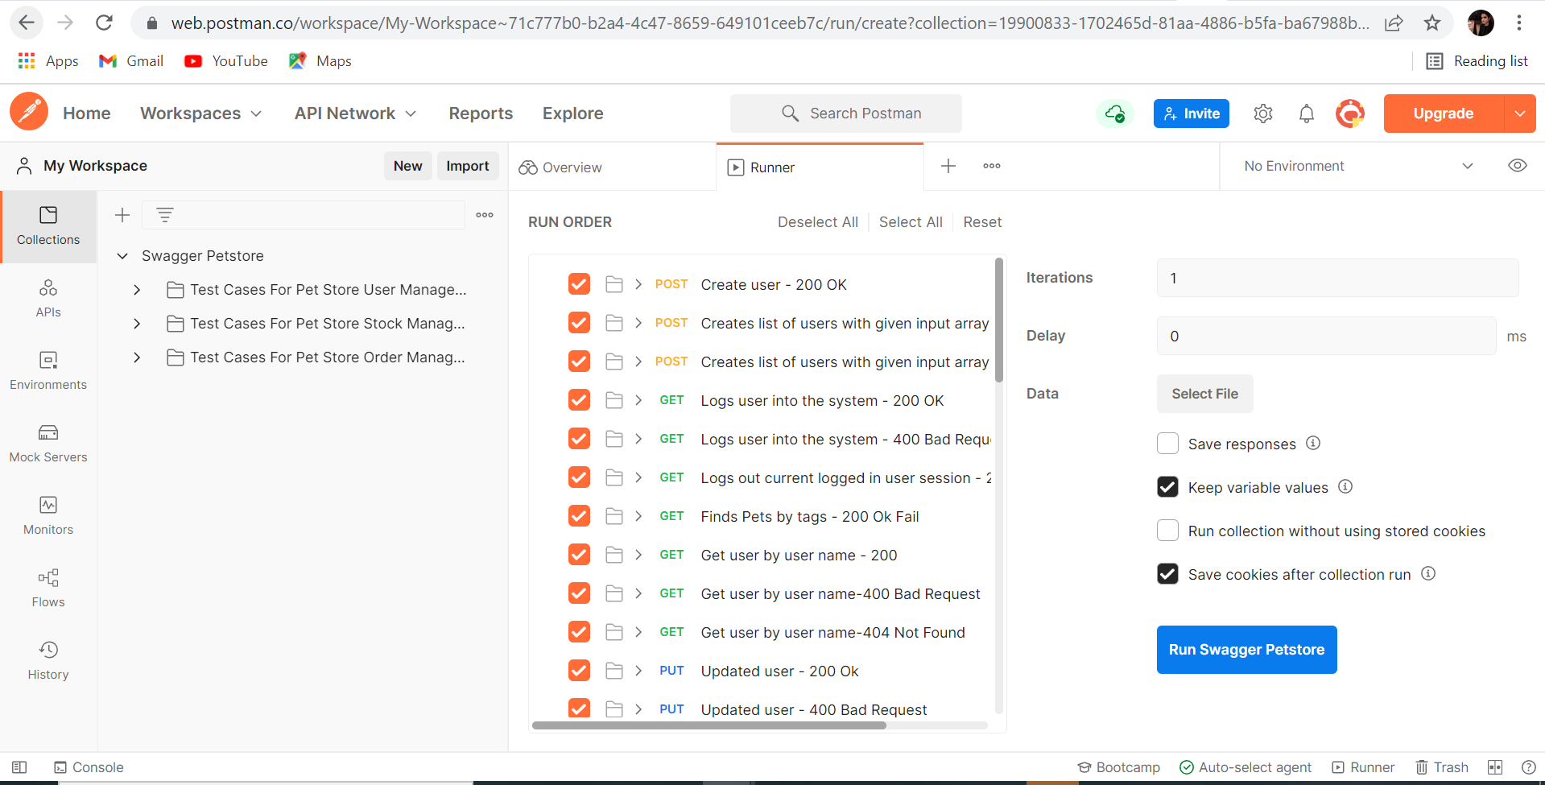
Automate POSTMAN Collection Execution in Runner

Slide 8
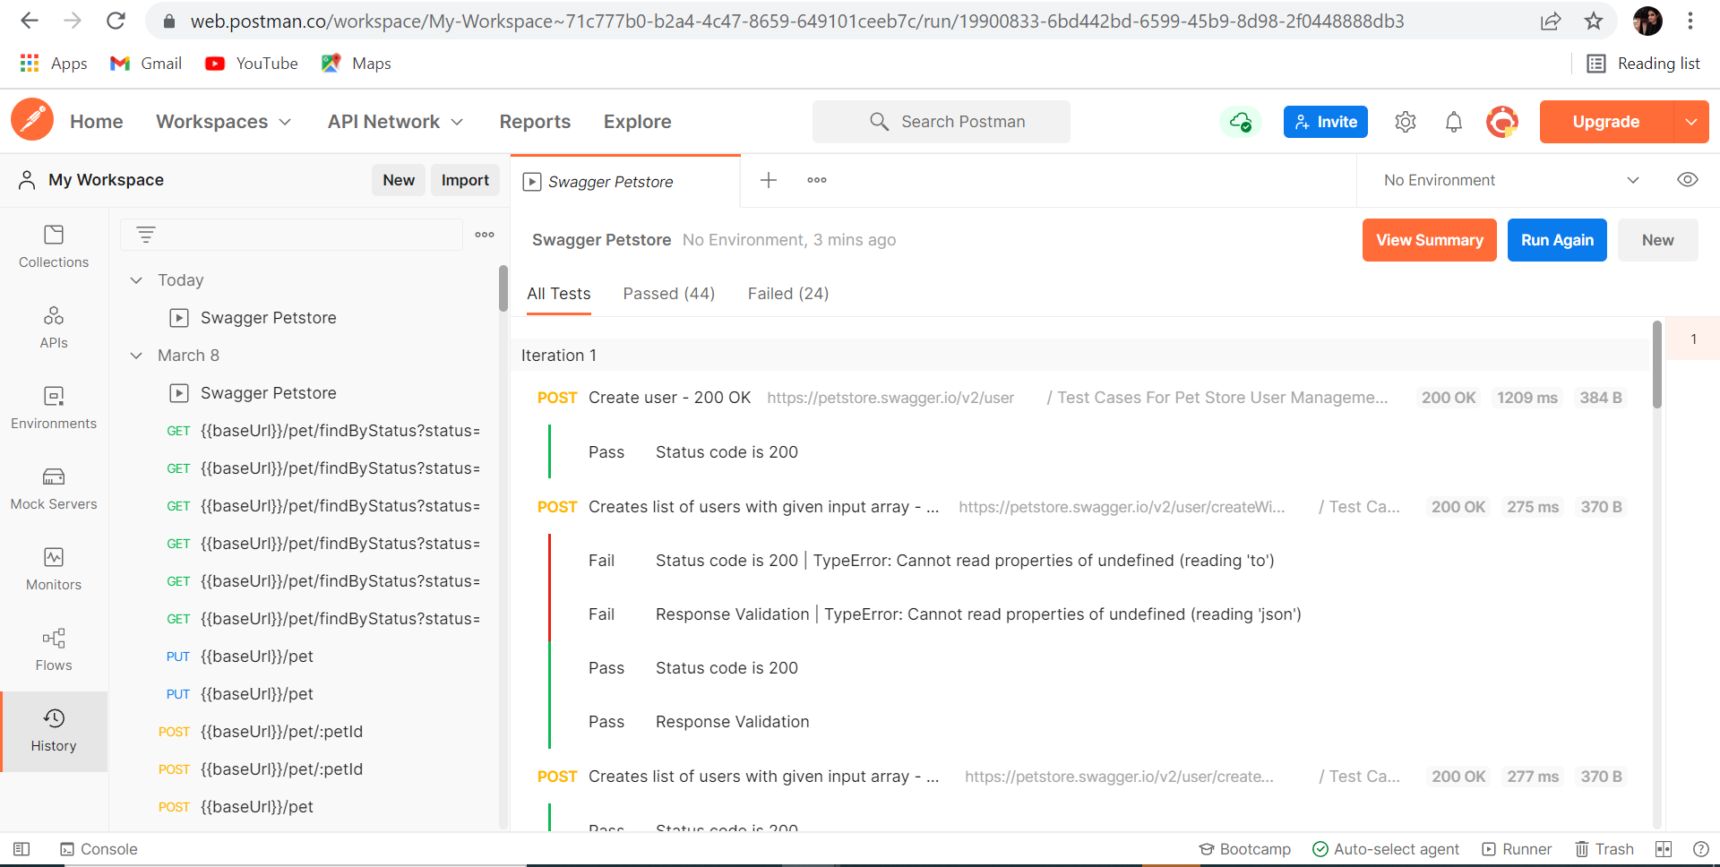
Automate POSTMAN Collection Execution in Runner
Copied Response :
https://web.postman.co/workspace/My-Workspace~71c777b0-b2a4-4c47-8659-649101ceeb7c/run/19900833-6bd442bd-6599-45b9-8d98-2f0448888db3

Slide 9
Automate POSTMAN Collection Execution in Runner
Running Postman Using Newman:
newman run <Path to File>\SwaggerPetstore.postman_collection.json --insecure --suppress-exit-code 1 -r htmlextra --reporter-htmlextra-export "%Workspace%\PostmanReport.html"
Double click on the icon

Slide 10
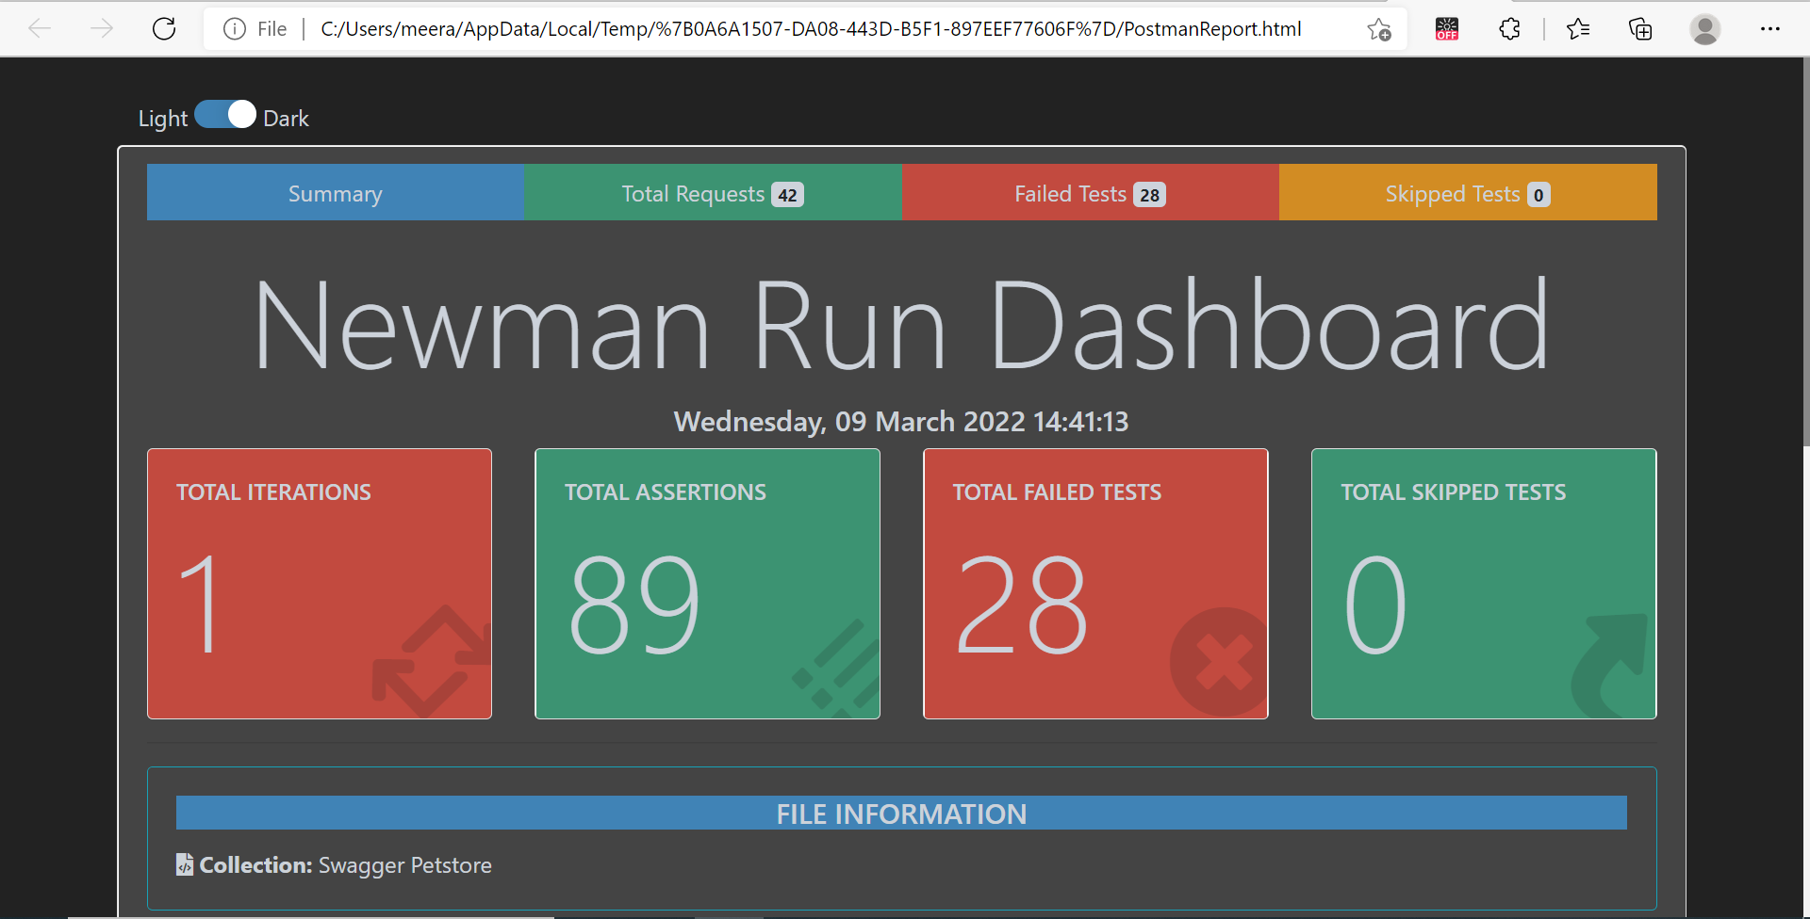
Automate POSTMAN Collection Execution in Runner
Running Postman Using Newman:

Slide 11
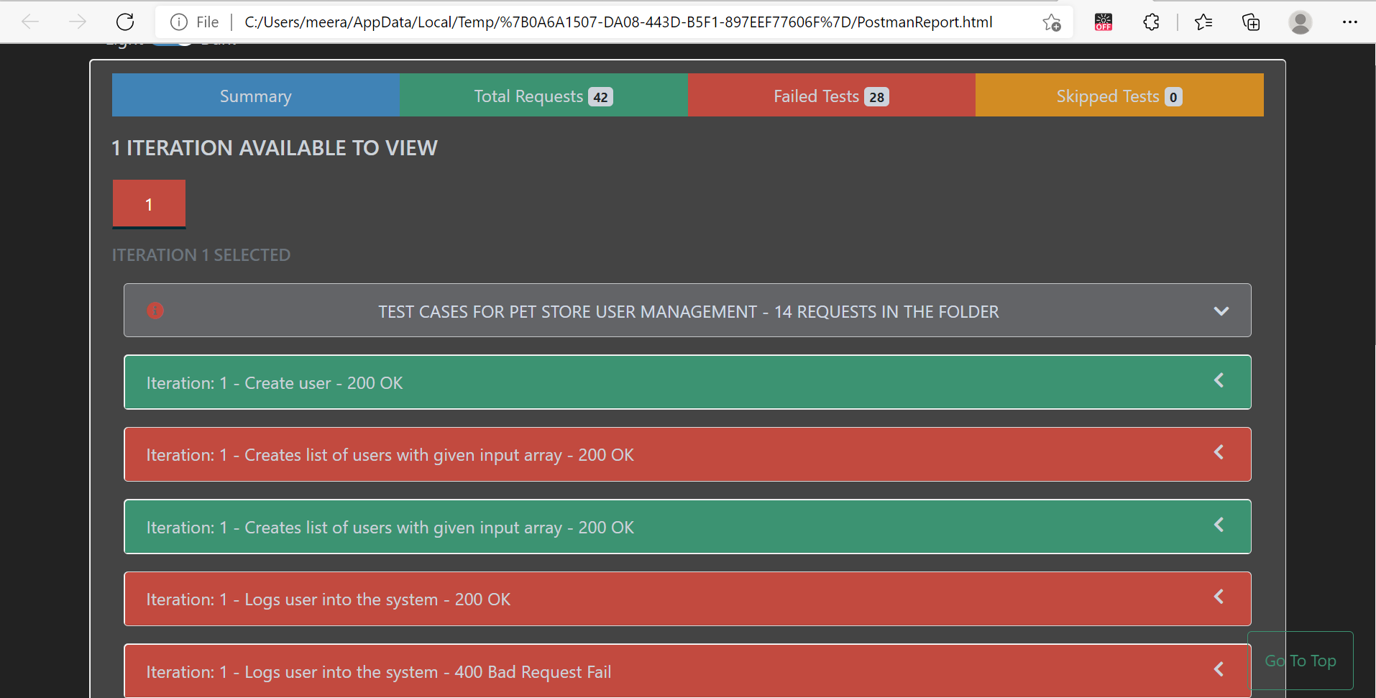
Automate POSTMAN Collection Execution in Runner
Running Postman Using Newman:

Slide 12
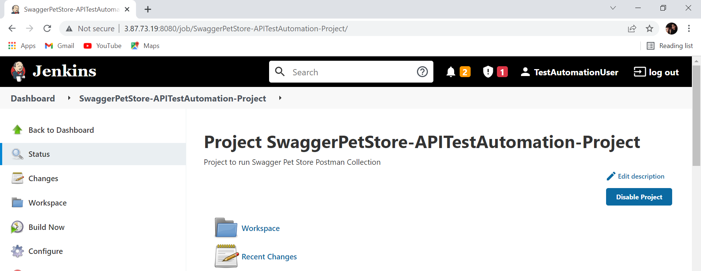
Automate POSTMAN Collection Execution in Runner
Running Postman in Jenkins:

Slide 13
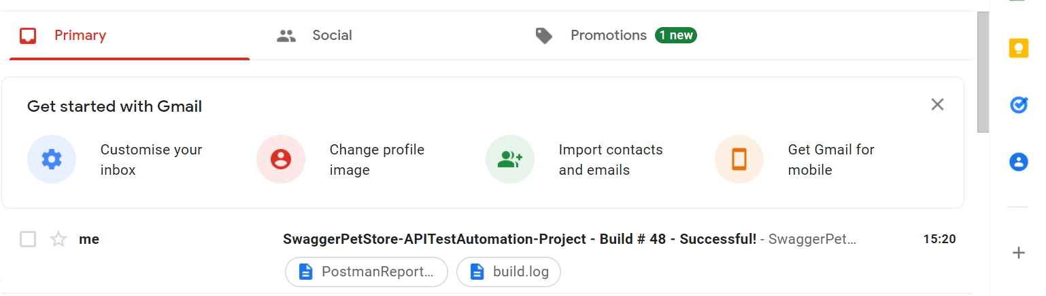
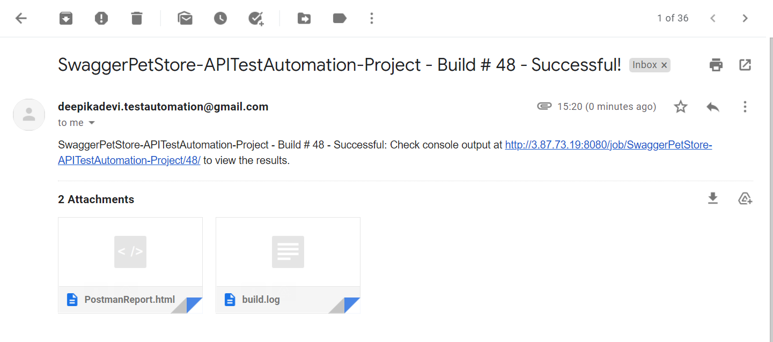
Automate POSTMAN Collection Execution in Runner
Running Postman in Jenkins:

Slide 14


